Slide 1
Phoebe's OSI Model Project
USA Charities
Team lead: Jayden Trujillo
Researchers: Matthew Orsini, Neveah Charles, Anika Bravo
Presenters: Gustavo Gambero, Nathan Bienamie, Matthew Orsini
8/28/24

Slide 2
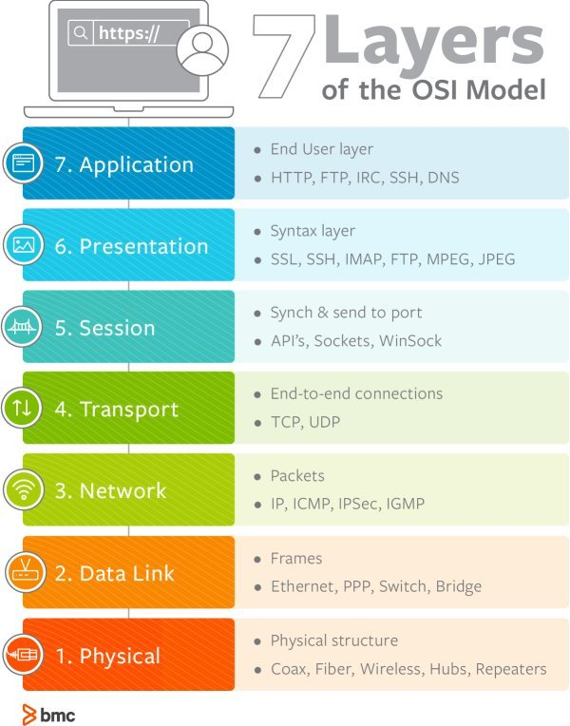
Outline
The OSI Model (Open Systems Interconnection) is a conceptual framework that divides communication processes into seven layers, each responsible for specific tasks.
It helps to understand and manage network communication, ensuring interoperability between different systems.

Slide 3
Layer 1 – Physical
The Physical layer is used for sending and receiving signals to be converted into bits of data.
Data can be sent and received both by cable or wirelessly.
Signaling used by this layer can be electrical, light or radio signals and translated into frames of data.

Slide 4
Layer 2 – Data Link layer
This layer is responsible for transporting data between nodes.
Frames data and adds a source and destination MAC addresses to each piece of information.
Detects and manages errors and slow receivers.
Communicates through Switches and WAPs.
Some devices used in this layer includes: Network Interface Card (NIC) & bridge networks

Slide 5
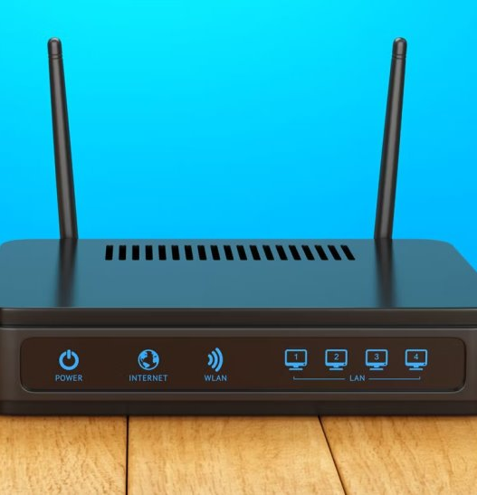
Layer 3 – Network layer
The network layer is responsible for the delivery end point systems getting their packets
network layer breaks downs and transmits data called packets
This layer is also responsible for the assignment of IPs.
The network layer is the internet's highway transporting routing and reassembling packets

Slide 6
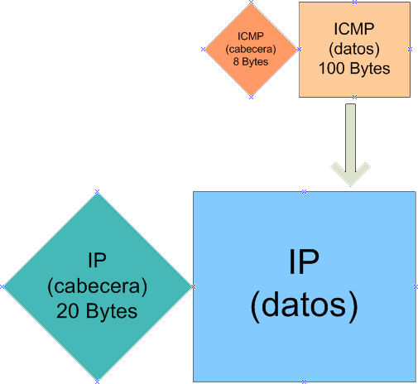
Layer 4 – Transport layer
The transport layer is responsible for delivery
Uses either TCP or UDP for transmission
When using TCP it sends ACK(acknowledgement) of reliable delivery
Breaks down the data into smaller units called segments and reassembles them at the destination

Slide 7
Layer 5 – Session Layer
Establishes, maintains, and terminates a session
Negotiate and agree on the mode of operation they will use- full-duplex, half-duplex, or simplex operation
Provide synchronization for data exchange, including checkpointing and recovery
Protocols- (PAP), (RPC), (PPTP)

Slide 8
Layer 6 – Presentation Layer
This encrypts and formats information to the application layer for further processing or display.
It compresses data to reduce the amount of data that needs to be transmitted.
It translates data between the application layer and the network format. This includes converting character encoding schemes, such as from to Unicode.
It converts data from a complex format into one that the application layer understands.

Slide 9
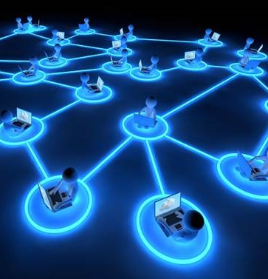
Layer 7 – Application layer
Purpose: This is the top layer, interacting directly with the user.
Functions: Provides network services to user applications.
Includes protocols like HTTP, FTP, SMTP, DNS.
Examples: Web browsers, email clients, file transfer applications. Like our NHS website or TESTOUT

Slide 10
Physical representation of the layers
Switches -data link layer
Routers – network layer
data checkpoint-session layer
Encryption- presentation layer
HTTP, HTTPS, DNS, SMTP - application layer
Hubs- physical layer

Slide 11
Sources
Sonali Tehraik. “Switches in Networking- Definitive Guide 2023.” Network Kings, 8 Oct. 2022, https://www.nwkings.com/switches-in-networking Accessed 28 Aug. 2024.
Abbey, Nitin. “What Are Routers in Networking?” STL Tech, 10 Jan. 2023, https://stl.tech/blog/what-are-routers-in-networking/
Admin. “Difference between Network Hub and Network Switch | STL.” STL Tech, 30 Nov. 2022, https://stl.tech/blog/difference-between-a-network-hub-and-network-switch/
What is Layer 5 of the OSI Model: Session Layer? | DDI (Secure DNS, DHCP, IPAM) | Infoblox
https://www.cloudflare.com/learning/network-layer/what-is-a-packet/#:~:text=The%20header%20contains%20information%20about,like%20a%20computer's%20mailing%20address).
Functions of session layers – Find Todays Notes (wordpress.com)

